Slide 1
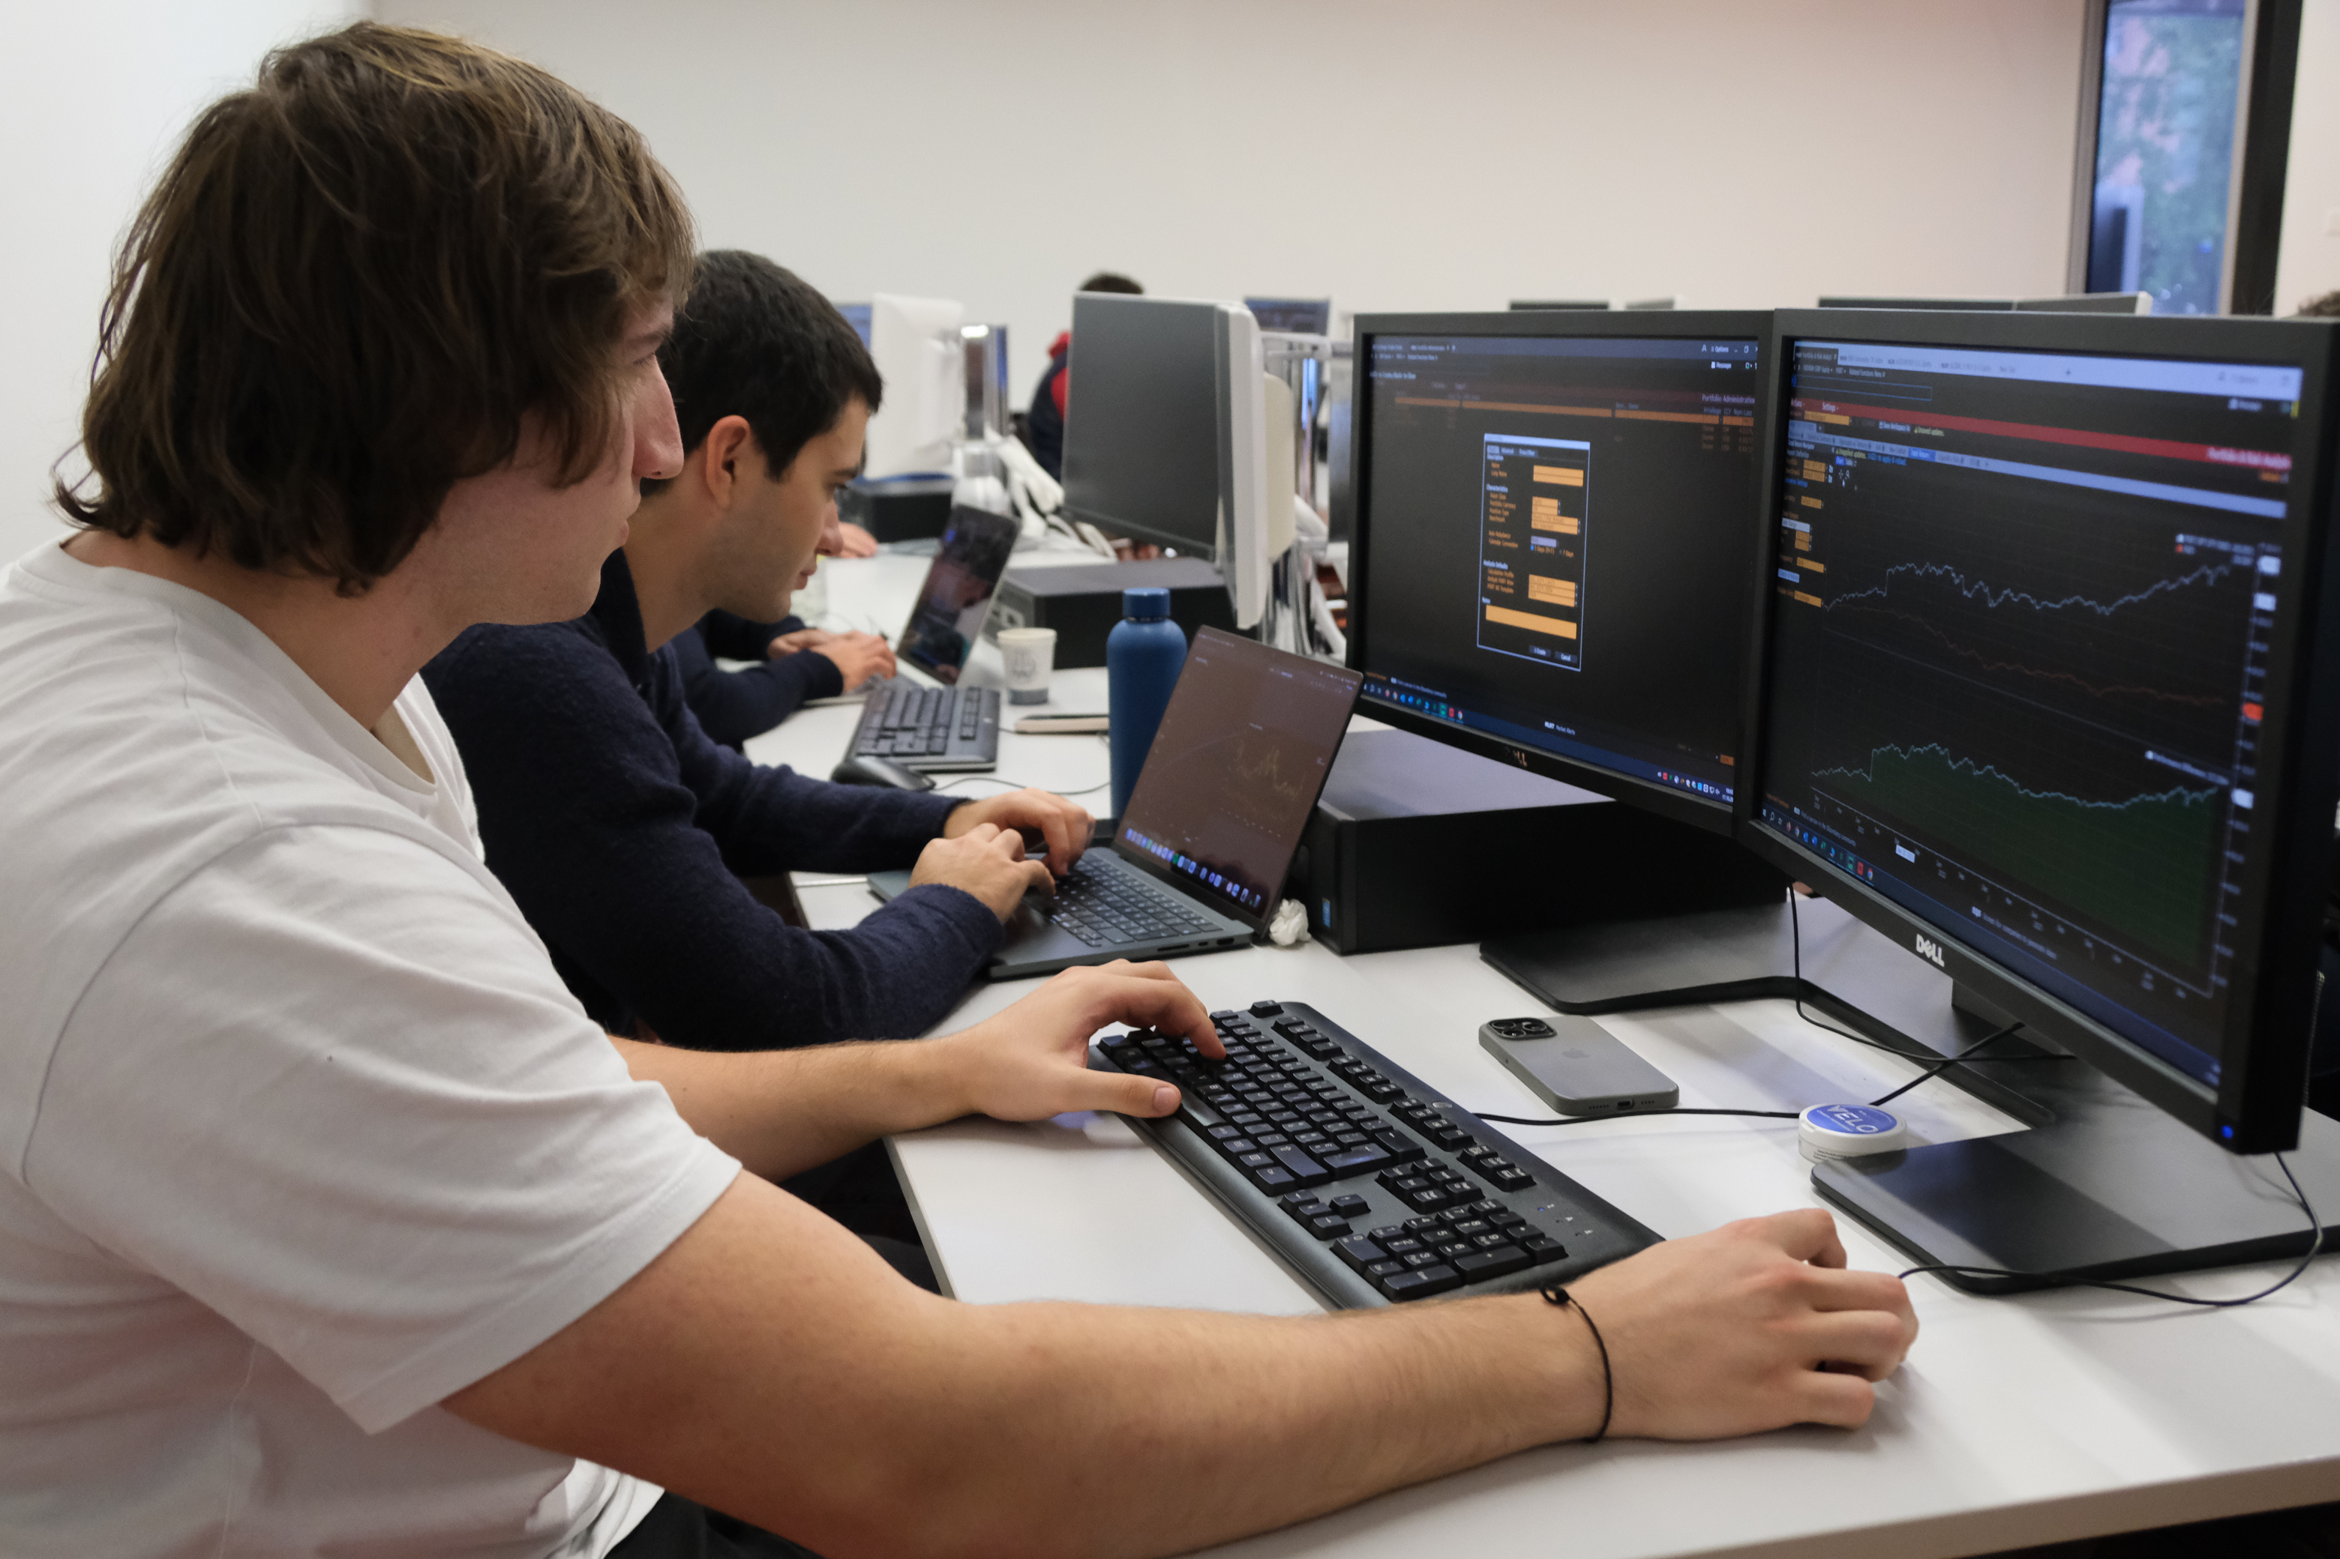

AURORA
CAPITAL MANAGEMENT
AMC Round 2 - Group 7
HTTPS://AURORACAPM.CH

Slide 2
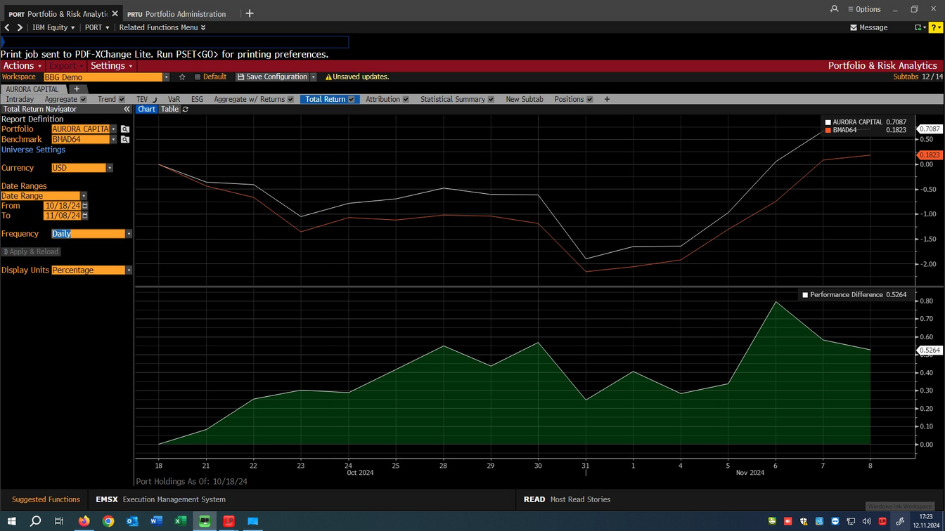
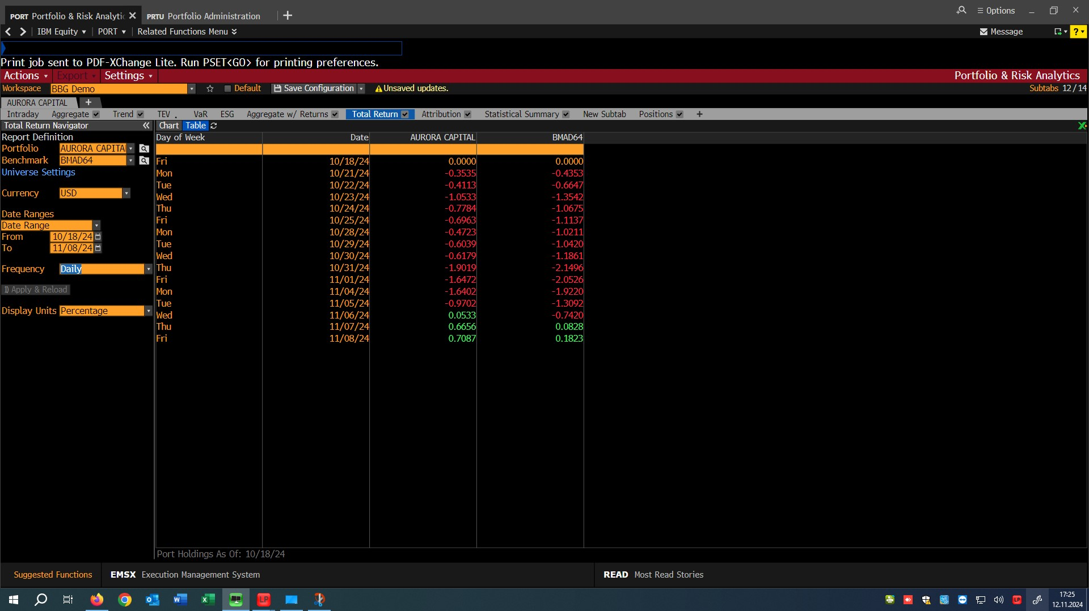
AURORA CAPITAL MANAGEMENT
RESULTS: 1ST ROUND
HTTPS://AURORACAPM.CH
Portfolio vs. Benchmark Performance Overview
Analysis Period:
October 18 - November 8, 2024
Aurora Capital outperformed the benchmark (BMADM64), showcasing resilience amid market volatility. Demonstrated quicker recovery and stronger performance, while mirroring benchmark trends but recovering faster.
Market Volatility (Oct 21 - Oct 31):
Aurora: -1.90%, Benchmark: -2.15%.
Aurora managed losses more effectively.
Recovery Phase (Nov 1 - Nov 8):
Aurora rebounded to 0.71% vs. Benchmark 0.18%
on Nov 8, achieving a 0.53% outperformance margin.

Slide 3
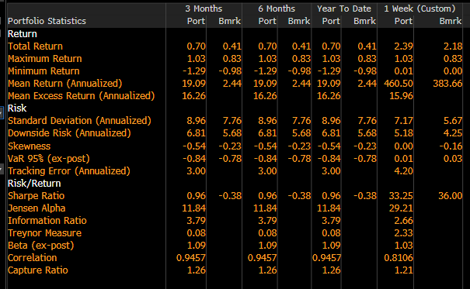
AURORA CAPITAL MANAGEMENT
RESULTS: 1ST ROUND
HTTPS://AURORACAPM.CH
Key metrics and
Risk-Adjusted Returns
1. Risk Management:
Sligthly Higher Standard Deviation: Aurora Capital experienced slightly more volatility than the benchmark, indicating a willingness to take on controlled risks for potentially higher returns.
Similar Downside Risk: Aurora’s downside risk was close to the benchmark, meaning it managed to control losses effectively even with increased volatility.
Comparable VaR: VaR was close to the benchmark, showing that the portfolio maintained a conservative approach. This means it didn't take on unnecessary risk despite pursuing outperformance.
2. Risk Adjusted Metrics:
Strong Sharpe Ratio: Aurora delivered strong risk-adjusted returns, suggesting that the portfolio was efficient in generating returns for the level of risk it took.
High Jensen Alpha: Aurora significantly outperformed expected returns based on market risk, highlighting the effectiveness of its active management strategy.
High Information Ratio: Aurora generated profitable returns from deviations, reflecting effective active management and decision-making.

Slide 4
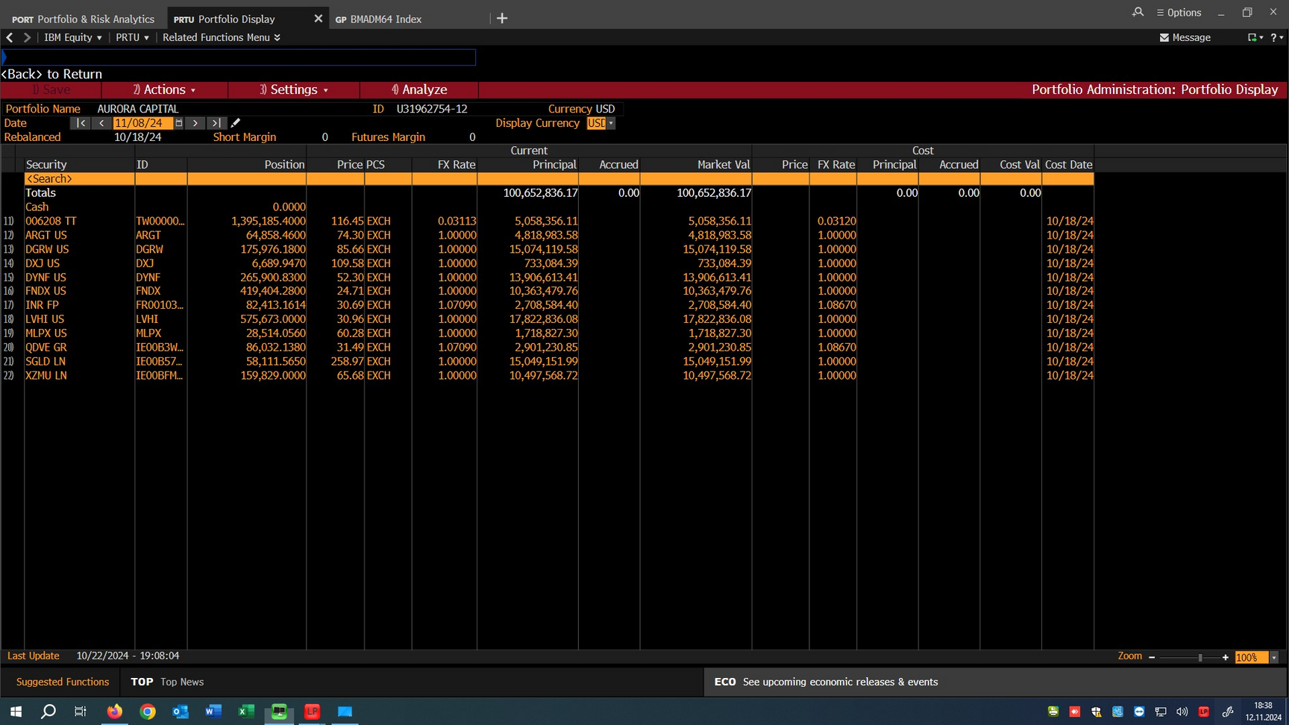
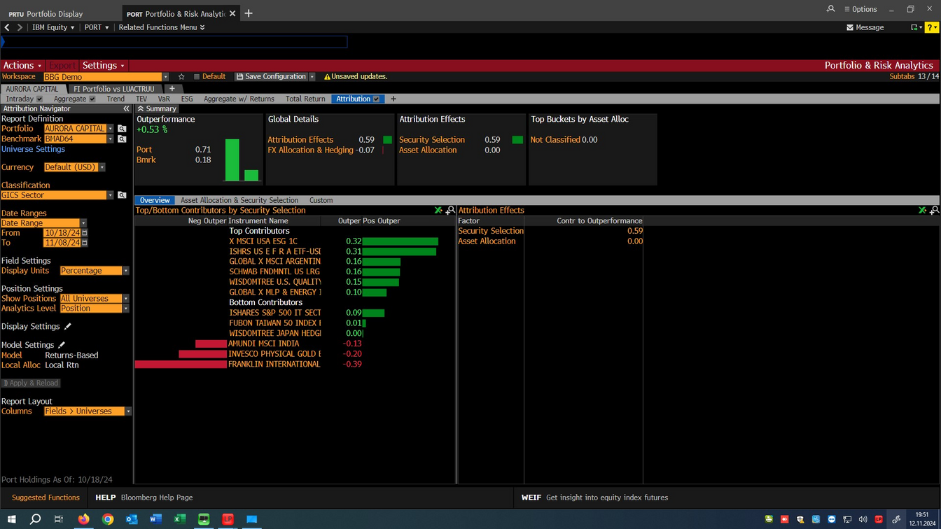
AURORA CAPITAL MANAGEMENT
RESULTS: 1ST ROUND
HTTPS://AURORACAPM.CH
Individual Position Performance Analysis
1. Overall Outperformance:
Aurora Capital achieved a +0.53% outperformance over the benchmark, driven primarily by security selection.
2. Key Contributors:
Top Performers: X MSCI USA ESG ETF (+0.32%) and ISHARES FTSE US (+0.31%) capitalized on strong U.S. market trends and ESG popularity.
Other Contributors: GLOBAL X MSCI ARGENTINA (+0.16%) and SHANDA FIN UTS LG (+0.16%) reflected gains in high-growth stocks and emerging markets.
3. Detractors:
INVESCO PHYSICAL GOLD (-0.19%): Declined due to reduced demand for safe-haven assets as investor sentiment shifted toward riskier investments.
FRANKLIN INTERNATIONAL (-0.39%): Faced challenges in international markets, affected by slower growth and currency impacts.
Portfolio Position at 08/11/24

Slide 5

ETF PORTFOLIO CHANGES
AURORA CAPITAL MANAGEMENT
HTTPS://AURORACAPM.CH
Reduced holdings in Indian equities:
Objective: Balance emerging market exposure
Reason: Active portfolio already includes emerging markets, freeing capital and enhancing diversification.
Reduced holdings in LVHI ETF:
Objective: Improve liquidity
Reason: Anticipated lower market volatility led to reduced LVHI exposure, reallocating funds to the active portfolio for potentially higher returns.
These adjustments provide liquidity, maintain a diversified risk profile, and enhance flexibility for active management.

Slide 6




ACTIVE PORTFOLIO
AURORA CAPITAL MANAGEMENT
HTTPS://AURORACAPM.CH
BLOOMBERG
ANALYSTS
EXCEL ANALYSIS
ALPHA
TREYNORD-BLACK MODEL
Bloomberg
We conducted research for finding the best analyst check on health, value, future growth
Implemented a 2 stage DCF model
Calculated stocks’ alpha to confirm the undervaluation
We implemented such model for calculating optimal allocation based on alpha-residual variance ratio
5 <= P/E Ratio <= 50
Current MarketCap > 1B
5 <= LF Diluted EPS <= 15
10 <= Price/FCF <= 20

Slide 7
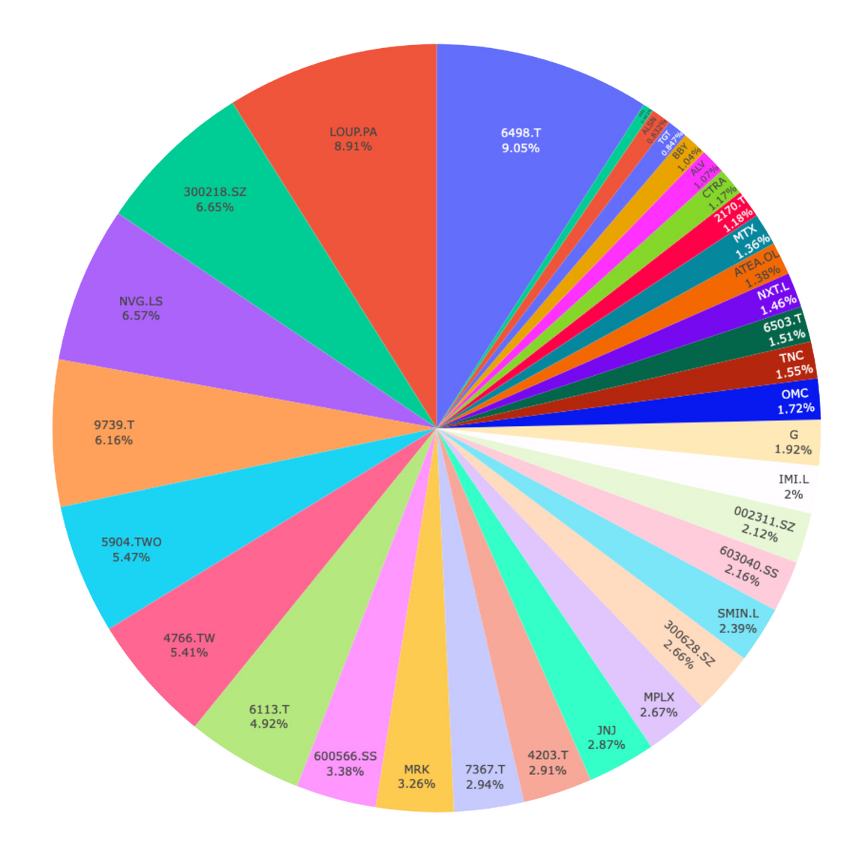
ACTIVE PORTFOLIO
AURORA CAPITAL MANAGEMENT
HTTPS://AURORACAPM.CH
Ticker | Alpha | Weight
6498.T | 0,1115 | 9,05%
LOUP.PA | 0,141 | 8,91%
300218.SZ | 0,1194 | 6,65%
NVG.LS | 0,1051 | 6,57%
9739.T | 0,0658 | 6,16%
See the excel file for full coverage |  | ..........

Slide 8
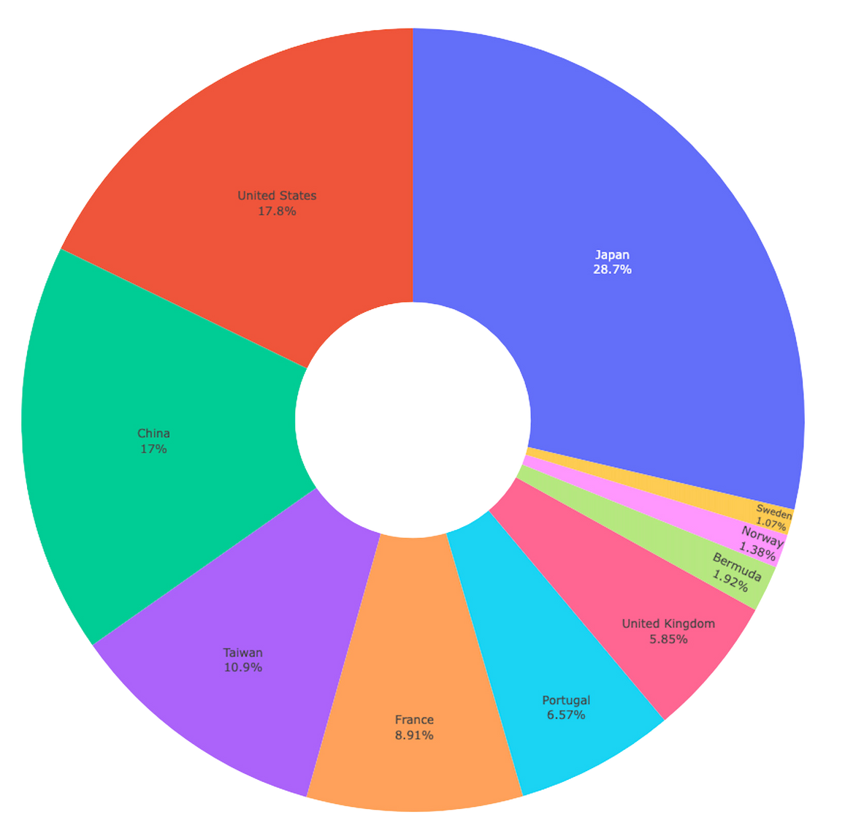
AURORA CAPITAL MANAGEMENT
ACTIVE PORTFOLIO
Allocation by Geographical Area
The portfolio’s geographical distribution prioritizes stability and growth, with a strong emphasis on Asia and developed markets. Japan holds the largest share at 28.7%, followed by the United States at 17.8%. Emerging markets in China (17%) and Taiwan (10.9%) also play a key role. European exposure includes France (8.91%), Portugal (6.57%), and the UK (5.85%), while smaller allocations in Sweden and Norway further diversification.
HTTPS://AURORACAPM.CH

Slide 9
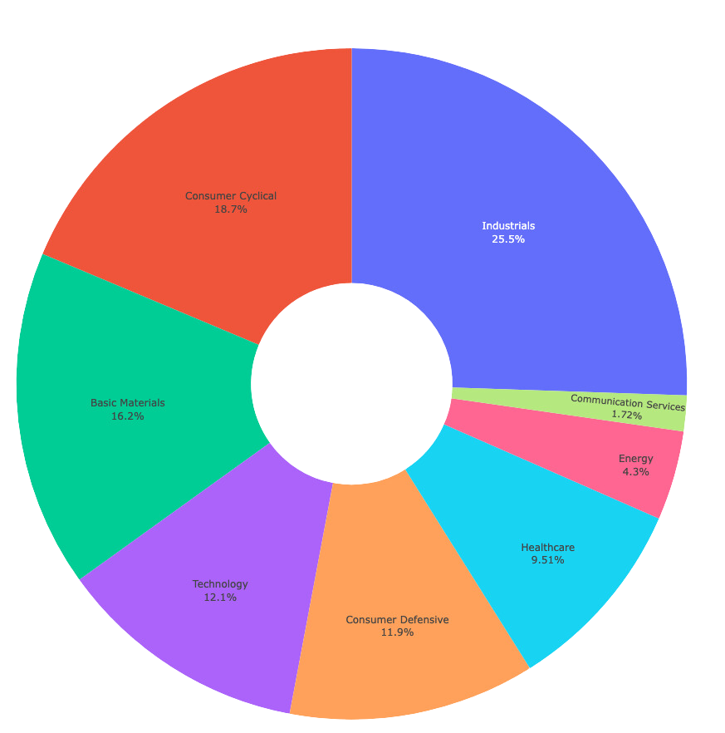
AURORA CAPITAL MANAGEMENT
ACTIVE PORTFOLIO
Allocation by Sector Area
The portfolio’s sector allocation is designed for balanced exposure. Industrials lead at 25.5%, followed by Consumer Cyclical (18.7%) and Basic Materials (16.2%), tapping into industrial growth and consumer spending. Technology (12.1%) adds innovation potential, while Consumer Defensive (11.9%) and Healthcare (9.51%) offer stability. Smaller allocations to Energy (4.3%) and Communication Services (1.72%) enhance diversification and long-term growth prospects.
HTTPS://AURORACAPM.CH

Slide 10
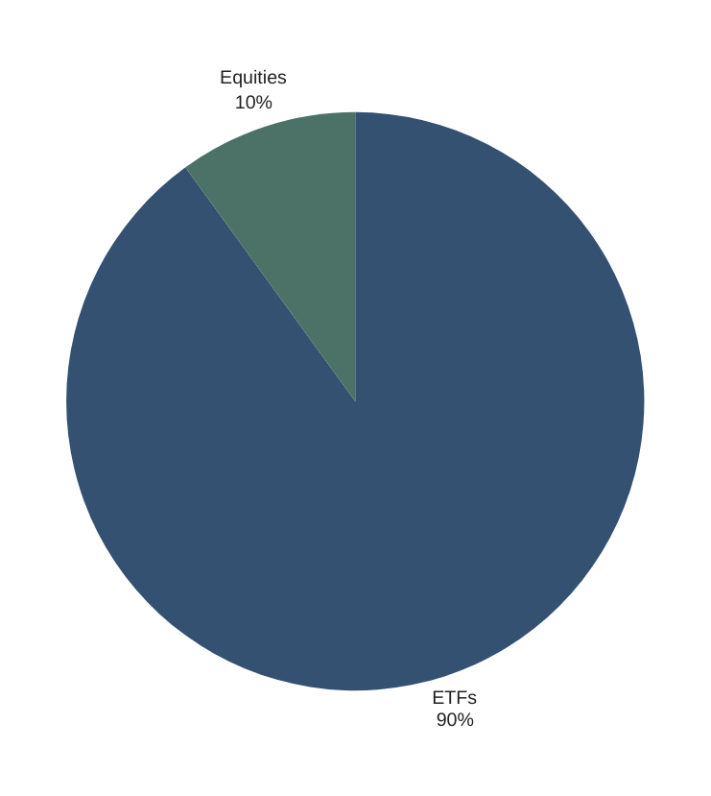
WHY 90% - 10%
HTTPS://AURORACAPM.CH
AURORA CAPITAL MANAGEMENT
Portfolio Allocation: 90% ETFs, 10% Equities
Balanced Approach: Following Treynor-Black, we allocate 90% to a diversified ETF portfolio and 10% to selected equities.
Optimizing Risk-Adjusted Return: This balance seeks to enhance the Sharpe Ratio by blending market stability with focused growth.
Rationale: ETFs offer low-cost diversification, while selected stocks aim to capture targeted alpha.
HTTPS://AURORACAPM.CH

Slide 11

LET'S CONNECT
+41 78 209 41 52
Thank You for Attention
info@auroracapm.ch
HTTPS://AURORACAPM.CH

